Slide 1
Lecture 5:
Remote Sensing and GIS

Slide 2
Remote Sensing and GIS
Any location on the earth has massive amounts of data tied to it, which not only include physical features, but political, economic and social data, as well.
GIS facilitates the process by which we can visualize, analyze and understand this data.
Remote sensing is one of the methods commonly used for collecting physical data to be integrated into GIS.
Remote sensors collect data from objects on the earth without any direct contact. They do this by detecting energy reflected from the earth, and are typically mounted on satellites or aircraft.
Remote sensing technology has become much more prevalent, accurate and accessible in recent years, and covers a wide range of engineering applications.

Slide 3
Can you recall Google Earth ?
The information in the Google earth is obtained through Remote Sensing
While its representation and management on geographical locations is made possible through GIS

Slide 4
Remote Sensing Definition
Remote sensing is an art and science of obtaining information about an object or feature without physically coming in contact with that object or feature.
These remotely collected data through various sensors may be analysed to obtain information about the objects or features under investigation.
remote sensing is the process of inferring surface parameters from measurements of the electromagnetic radiation (EMR) from the Earth‘s surface.
This EMR can either be reflected or emitted from the Earth‘s surface.
In other words, remote sensing is detecting and measuring electromagnetic (EM) energy emitted or reflected from distant objects made of various materials, so that we can identify and categorize these objects by class or type, substance and spatial distribution

Slide 5
By recording emitted or reflected radiation and applying knowledge of its behavior as it passes through the Earth’s atmosphere and interacts with objects, remote sensing analysts develop knowledge of the character of features such as vegetation, structures, soils, rock, or water bodies on the Earth’s surface.

Slide 6
Basic concepts of remote sensing
Electromagnetic energy or electromagnetic radiation (EMR) is the energy propagated in the form of an advancing interaction between electric and magnetic fields.
It travels with the velocity of light. Visible light, ultraviolet rays, infrared rays, heat, radio waves, X-rays all are different forms of electro-magnetic energy.
Electro-magnetic energy (E) can be expressed either in terms of frequency (f) or wave length (λ) of radiation as E = h c f or h c / λ
where h is Planck's constant (6.626 x 10-34 Joules-sec), c is a constant that expresses the celerity or speed of light (3 x 108 m/sec), f is frequency expressed in Hertz and λ is the wavelength expressed in micro meters (1μm = 10-6 m).

Slide 7
Basic concepts of remote sensing
As can be observed from this equation, shorter wavelengths have higher energy content and longer wavelengths have lower energy content.
Distribution of the continuum of energy can be plotted as a function of wavelength (or frequency) and is known as the EMR spectrum
All matters reflect, emit or radiate a range of electromagnetic energy, depending upon the material characteristics.
In remote sensing, it is the measurement of electromagnetic radiation reflected or emitted from an object, is the used to identify the target and to infer its properties.

Slide 8
Principles of Remote Sensing
Different objects reflect or emit different amounts of energy in different bands of the electromagnetic spectrum.
The amount of energy reflected or emitted depends on the properties of both the material and the incident energy (angle of incidence, intensity and wavelength).
Detection and discrimination of objects or surface features is done through the uniqueness of the reflected or emitted electromagnetic radiation from the object.
A device to detect this reflected or emitted electro-magnetic radiation from an object is called a ―sensor‖ (e.g., cameras and scanners). A vehicle used to carry the sensor is called a ―platform‖ (e.g., aircrafts and satellites).

Slide 9
Main stages in remote sensing
Emission of electromagnetic radiation: The Sun or an EMR source located on the platform
Transmission of energy from the source to the object: Absorption and scattering of the EMR while transmission
Interaction of EMR with the object and subsequent reflection and emission: Transmission of energy from the object to the sensor
Recording of energy by the sensor : Photographic or non-photographic sensors
Transmission of the recorded information to the ground station
Processing of the data into digital or hard copy image
Analysis of data

Slide 10
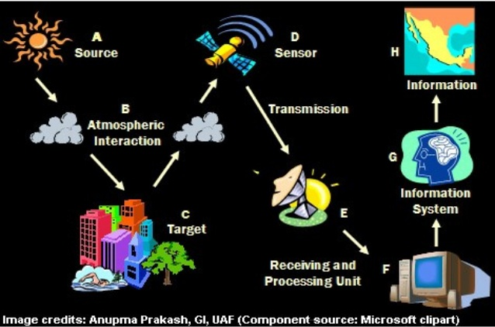
Main stages in remote sensing

Slide 11
Passive/ Active Remote Sensing
Depending on the source of electromagnetic energy, remote sensing can be classified as passive or active remote sensing.
In the case of passive remote sensing, source of energy is that naturally available such as the Sun.
Most of the remote sensing systems work in passive mode using solar energy as the source of EMR.
Solar energy reflected by the targets at specific wavelength bands are recorded using sensors on board air-borne or space borne platforms.
In order to ensure that signal strength received at the sensor, wavelength / energy bands capable of traversing through the atmosphere, without significant loss through atmospheric interactions, are generally used in remote sensing

Slide 12
Passive/ Active Remote Sensing
In the case of active remote sensing, energy is generated and sent from the remote sensing platform towards the targets.
The energy reflected back from the targets are recorded using sensors on board the remote sensing platform.
Most of the microwave remote sensing is done through active remote sensing.
As a simple analogy, passive remote sensing is similar to taking a picture with an ordinary camera whereas active remote sensing is analogous to taking a picture with camera having built-in flash

Slide 13
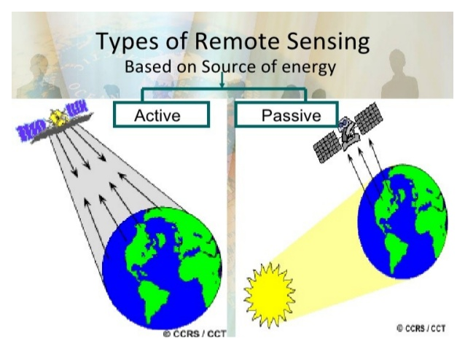
Passive/ Active Remote Sensing

Slide 14
The Difference between Remote Sensing and GIS
Remote Sensing:
It is a surveying and data collection technique.
It can retrieve large amounts of data.
It reduces manual field work dramatically.
It allows retrieval of data in regions difficult or impossible to access.
It allows collection of more data in a short period of time.
Mostly use in data collection.
Has a more complex user interface.
It covers a limited study area at a time.
Less ideal for communicating information between departments.

Slide 15
The Difference between Remote Sensing and GIS
GIS:
It is a computer system consisting of hardware and software.
It can cope with larger amounts of data.
It can cover large study areas.
It can cope with unlimited and frequent data edits.
More robust and resistant to damage.
Faster and more efficient.
It requires less person, time and money.
Mostly used for data analysis.
Has a more simplified user interface.
Is an ideal tool for communication between different departments.

Slide 16
Electromagetic remote sensing of earth and its processing

Slide 17
Advantages and Disadvantages of Remote Sensing
Advantages of remote sensing are:
Provides data of large areas
Provides data of very remote and inaccessible regions
Able to obtain imagery of any area over a continuous period of time
Relatively inexpensive when compared to employing a team of surveyors
Easy and rapid collection of data
Rapid production of maps for interpretation
Disadvantages of remote sensing are:
The interpretation of imagery requires a certain skill level
Needs cross verification with ground (field) survey data
Data from multiple sources may create confusion
Objects can be misclassified or confused
Distortions may occur in an image due to the relative motion of
sensor and source

